Slide 1
Class 2: Probability Review
Alison Presmanes Hill
2017-09-28

Slide 2
Suppose you’re on a game show, and you’re given the choice of three doors. Behind one door is a car, behind the others, goats. You pick a door, say #1, and the host, who knows what’s behind the doors, opens another door, say #3, which has a goat. He says to you, "Do you want to pick door #2?" Is it to your advantage to switch your choice of doors? Craig F. Whitaker Columbia, Maryland
In 1990, the following question appeared
in Parade Magazine’s “Ask Marilyn” column:

Slide 3
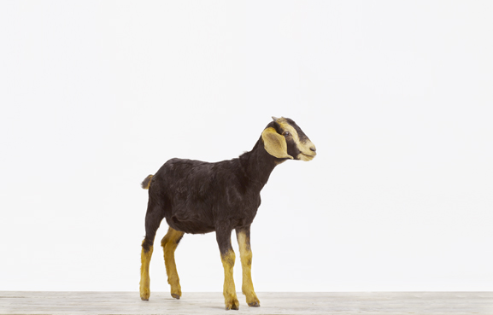
Yes; you should
Switch
-- Marilyn vos Savant
http://marilynvossavant.com/game-show-problem/

Slide 4
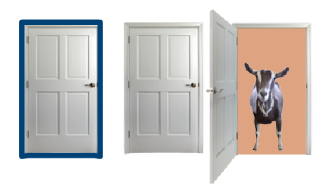
What’s the Best Strategy?
If you always switch doors after Monty Hall reveals a goat, then your odds of winning are two-in-three, or 66.7 percent on average. If you keep your original choice, your chances of winning are just one-in-three, or 33 percent on average.
That seems weird, because after Monty reveals a goat, there are two closed doors left, and it might seem as if there should be a 50-50 chance that the car is behind either door.

Slide 5
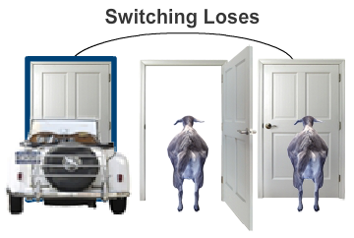
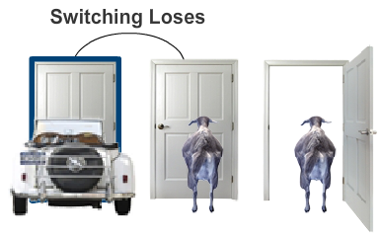
How to lose by switching
To help explain, let’s look at the situation from the other side, so we have as much information as Monty Hall does. The critical aspect of the problem is that Monty Hall always opens a door to reveal one of the goats.
If you correctly chose the door with the car at the start, he can open either of the other doors to reveal a goat. If you accept his offer to switch doors, you will switch away from your winning choice and end up with a goat. So far, switching doesn’t sound like a winning strategy.

Slide 6
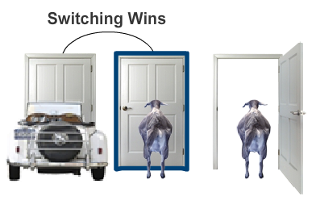
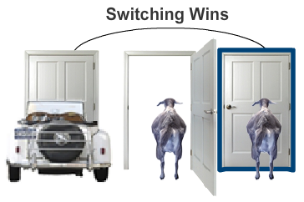
How to win by switching
But look what happens if your initial choice of door was hiding a goat. If you picked the middle door, Monty Hall opens the third door to show you a goat. In this case, if you switch doors, you switch to the door hiding the car.
The same situation applies if you chose the third door initially. (Remember, Monty Hall knows where the car is and needs to open a door that will reveal a goat.) Again, switching from your initial choice to the other closed door means you trade a goat for a car.

Slide 7
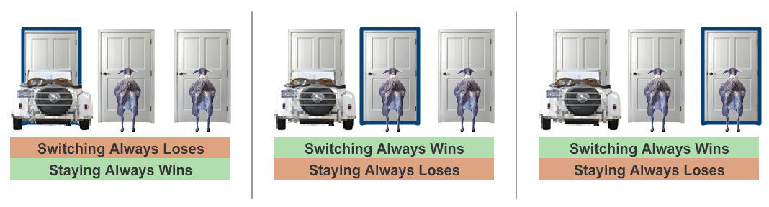
If your strategy is to always switch doors, you will lose only if your initial choice is the door with the car, which is a 33.3 percent chance. In the other two cases (66.7 percent of the time) you will switch to the car and walk away a winner.
You stay
You switch
Win 33.3%
Win 33.3%
Win 33.3%

Slide 8
“Our brains are just not
wired
to do probability problems well.”
-- Persi Diaconis
Professor of Statistics & Mathematics
Stanford University
http://www.nytimes.com/1991/07/21/us/behind-monty-hall-s-doors-puzzle-debate-and-answer.html

Slide 9
As a professional mathematician, I’m very concerned with the general public’s lack of mathematical skills. Please help by confessing your error and in the future being more careful. Robert Sachs, Ph.D. George Mason University
You made a mistake, but look at the positive side. If all those Ph.D.’s were wrong, the country would be in some very serious trouble. Everett Harman, Ph.D. U.S. Army Research Institute
May I suggest that you obtain and refer to a standard textbook on probability before you try to answer a question of this type again? Charles Reid, Ph.D. University of Florida
I am sure you will receive many letters on this topic from high school and college students. Perhaps you should keep a few addresses for help with future columns. W. Robert Smith, Ph.D. Georgia State University

Slide 10
"I wrote her another letter telling her that after removing my foot from my mouth I'm now eating
humble pie.
I vowed as penance to answer all the people who wrote to castigate me. It's been an intense professional
embarrassment."
--Dr. Robert Sachs
http://www.nytimes.com/1991/07/21/us/behind-monty-hall-s-doors-puzzle-debate-and-answer.html

Slide 11
What is probability?
A measure of chance that something will occur.
Probability theory is the mathematical machinery necessary to answer questions about uncertain events that occur randomly.
As scientists/engineers, we need to be more precise…

Slide 12
Random Experiment:
An experiment, trial, or observation that can be repeated numerous times under the same conditions.
The outcome of an individual random experiment must be independent and identically distributed.
It must in no way be affected by any previous outcome and cannot be predicted with certainty.
http://cnx.org/content/m13470/latest/

Slide 13
Random Experiment:
Experiment is repeatable (ideally)
Outcomes are iid
Outcomes are uncertain
http://cnx.org/content/m13470/latest/

Slide 14
What does iid mean?
independent
identically
distributed
What it does not mean:
Independent ≠ uncorrelated
“identically distributed” ≠ equally likely

Slide 15
(𝛀, 𝓕, 𝐏)
Probability Triple

Slide 16
The probability triple
a random experiment!!!
From Wikipedia:
“a probability triple is a mathematical construct that models a real-world process (or "experiment") consisting of states that occur randomly.”
A probability triple has (predictably) 3 parts:
𝛀 | Sample space | The set of outcomes that we are sampling from.
𝓕 | Set of events | What are the sane questions I can ask about this probability distribution?
𝐏 | Probability measure | Function that maps elements from 𝓕 to the interval [0, 1]

Slide 17
The probability triple
Given a random experiment…
𝛀 | Sample space | What can possibly happen?
𝓕 | Set of events | What are the sane questions I can ask about this probability distribution?
𝐏 | Probability measure | Function that maps elements from 𝓕 to the interval [0,1]

Slide 18
Sample space (𝛀)
The sample space is the set containing all possible outcomes from a random experiment
“What can possibly happen (in the context of the random experiment?”
Possible ≠ probable

Slide 19
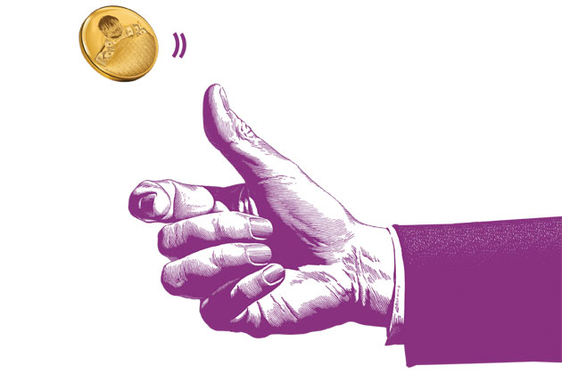
Random experiment: toss a fair coin 2 times
“An idealized coin consists of a circular disk of zero thickness which, when thrown in the air and allowed to fall, will rest with either side face up ("heads" H or "tails" T) with equal probability.”
http://mathworld.wolfram.com/CoinTossing.html

Slide 20
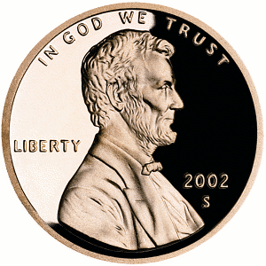
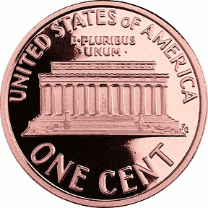
Sample space (𝛀)
“What can possibly happen?”

Slide 21


Sample space (𝛀)
“What can possibly happen?”
“What can not possibly happen?”

Slide 22
(𝛀, 𝓕, 𝐏)
✓
Probability Triple

Slide 23
Outcomes (𝛚)
One outcome is one element in the sample space, 𝛚_{1,…n}∈𝛀
𝛚₁
𝛚₂
𝛀
𝛚₃
𝛚₄

Slide 24
Outcomes (𝛚)
𝛚
The set of all outcomes is denoted 𝛚 such that 𝛚∈𝛀
𝛚₁
𝛚₂
𝛀
𝛚₃
𝛚₄

Slide 25
Events (A, B, etc.)
An event is a set of outcomes to which a probability is assigned
Notation: capital letters (i.e., A)
The actual letter means nothing
By definition, set of events is a subset of the sample space
A ⊆ 𝛀

Slide 26
Event A: same result on both flips
𝛚₁
𝛚₂
𝛀
𝛚₃
A
𝛚₄

Slide 27
Event B: exactly one head
𝛚₁
B
𝛚₂
𝛀
𝛚₃
𝛚₄

Slide 28
Event C: two heads
𝛚₁
C is an elementary event
𝛚₂
𝛀
𝛚₃
C
𝛚₄

Slide 29
(𝛀, 𝓕, 𝐏)
✓
✓
Probability Triple

Slide 30
Pictures are difficult to do math with…
𝛚₁
𝛚₂
𝛀
𝛚₃
𝛚₄

Slide 31
Letters are also difficult to do math with…
1st flip
f₁
2nd flip
f₂
H
T
𝛚₁ = {f₁ = H ∩ f₂ = T}
T
H
𝛚₂ = {f₁ = T ∩ f₂ = H}
𝛀
H
H
𝛚₃ = {f₁ = H ∩ f₂ = H}
T
T
𝛚₄ = {f₁ = T ∩ f₂ = T}

Slide 32
Letters are also difficult to do math with…
1st flip
f₁
2nd flip
f₂
H
T
You need a function that maps outcomes and events
onto real numbers
𝛚₁ = {f₁ = H ∩ f₂ = T}
T
H
𝛚₂ = {f₁ = T ∩ f₂ = H}
𝛀
H
H
𝛚₃ = {f₁ = H ∩ f₂ = H}
T
T
𝛚₄ = {f₁ = T ∩ f₂ = T}

Slide 33
Random variables
neither random nor variables

Slide 34
Random variable
A function that associates a real number with an event
Input: 𝛀
Output: numeric sample space
𝛀 | Sample space | The set of outcomes that we are sampling from.

Slide 35
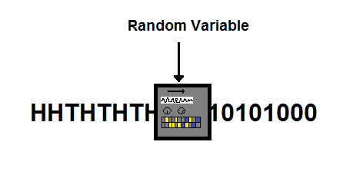
Input:
𝛚
Output:
real numbers
http://www.countbayesie.com/blog/2015/2/20/random-variables-and-expectation

Slide 36
Input:
𝛚
Output:
real numbers
2 billion, 0, 0, 2 billion
Arbitrary, nothing to do with probability yet
http://www.countbayesie.com/blog/2015/2/20/random-variables-and-expectation

Slide 37
H
T
X(𝛚₁) = 1
T
H
X(𝛚₂) = 1
𝛀
H
H
X(𝛚₃) = 2
T
T
X(𝛚₄) = 0

Slide 38
H
T
X(𝛚₁) = 1
These are x
T
H
X(𝛚₂) = 1
𝛀
H
H
X(𝛚₃) = 2
T
T
X(𝛚₄) = 0

Slide 39
Random variables: formalization
Capital letters used to denote (X, Y, Z, etc.)
Let Q = set of real numbers ℝ
Random variable (rv): X is a function X: 𝛀 →Q
Discrete rv: Q ⊆Z countable set, e.g., a subset of integers
Continuous rv: Q ⊆ ℝ is a subset of real numbers
A function f(X) of a rv is also an rv

Slide 40
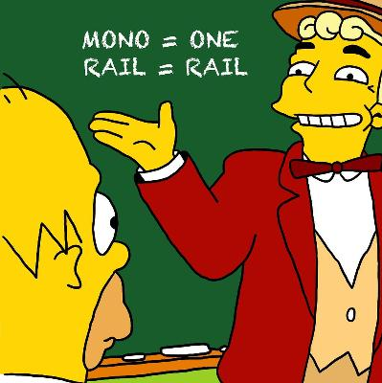
Random variables: X, Y, Z, etc.
Same letter, but in lower case, used to represent the outcomes or observed values
This is not a typo, it actually means something: X = x “the event that rv X takes on the value x”
Why call it an rv?
Random because observed value depends on outcome of random experiment
Variable because different values are possible

Slide 41
Random
Variable
Probability distribution function
TTHHtHT
01001000111
½ ½ ½ ½ ½

Slide 42
Probability distribution function
Input: real numbers X(𝛚) = x
Output: always between 0 and 1
01001000111
½ ½ ½ ½ ½ ½
Output: always sum to 1

Slide 43
Simple probability
If I flip a fair penny, the probability of heads is 50%
𝑝(H) = 𝑝(T) = .5
𝛀 = {(H), (T)}
𝛚 = {(H), (T)}
X(𝛚) = 1 iff 𝛚 = H; X(𝛚) = 0 iff 𝛚 = T
P(X(𝛚) = 1) = 0.5
But what if I flip two coins?

Slide 44
Equally likely (ordered) outcomes
1st flip
f₁
2nd flip
f₂
If I flip two fair pennies, the probability of heads on each flip is still 50%
𝑝(H) =𝑝(T) = .5
All ordered outcomes here are equally likely
P(H, T) = P(H ∩ T) = .5 ⨉ .5 = ¼
P(H, T) = P(T, H) = ¼ so the probabilities are equal, but 𝛚₁ ≠𝛚₂ in the sample space 𝛀
𝛚₁
𝛚₂
𝛀
𝛚₃
𝛚₄

Slide 45
X(𝛚) ignores order, but that doesn’t mean that order does not matter when defining 𝛚∈𝛀 or P(X(𝛚))
X(𝛚)
probability
H
T
1
.25
T
H
1
.25
𝛀
H
H
2
.25
T
T
0
.25

Slide 46
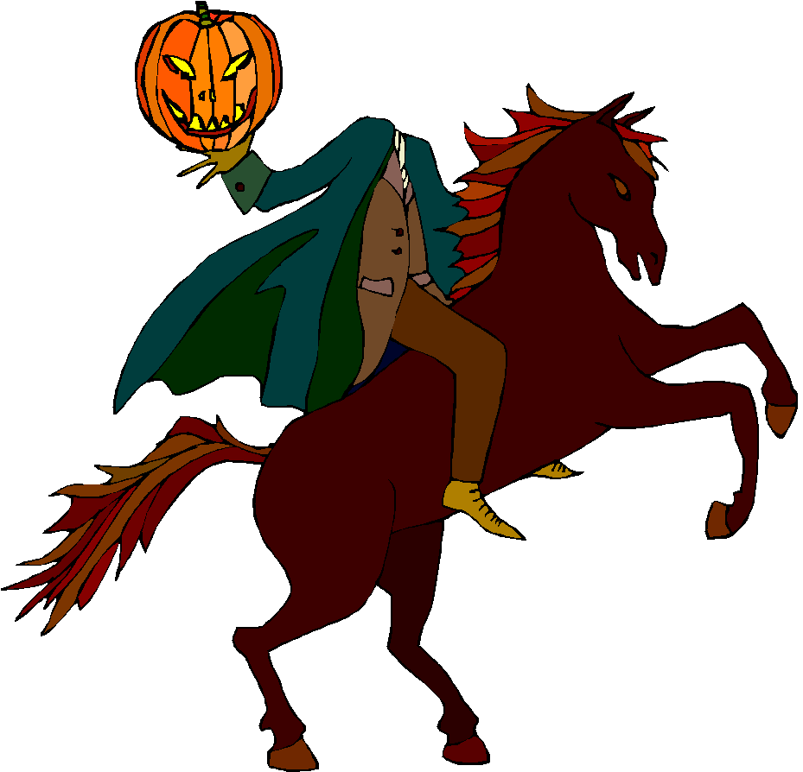
X(𝛚) = x
P(X(𝛚) = x)
H
1
.5
This notation is getting pretty cumbersome
H
H
2
.25
0
.25

Slide 47
X = x
P(X = x)
X(𝛚) = x
P(X(𝛚) = x)
H
1
.5
This notation is getting pretty cumbersome
H
H
2
.25
0
.25

Slide 48
x
P(x)
X = x
P(X = x)
equivalent
X(𝛚) = x
P(X(𝛚) = x)
H
1
.5
This notation is getting pretty cumbersome
H
H
2
.25
0
.25

Slide 49
P_{X}(x)
x
P(x)
X = x
P(X = x)
equivalent
X(𝛚) = x
P(X(𝛚) = x)
H
1
.5
This notation is getting pretty cumbersome
H
H
2
.25
0
.25

Slide 50
These things are all different!
Events: e.g., a fair coin flip lands on its tail
This is an elementary event b/c refers to 1 outcome
A random variable: e.g., X
More clearly and less compactly: X(ω)
Observation of a random variable: e.g., X = 5
More clearly and less compactly: X(ω) = 5
A parameter: e.g., the probability 𝑝 of heads is ½
Distinguish between what is random but attainable (actual data)
vs.
the unknown but ultimately important true state of nature (parameters).

Slide 51
Kolmogorov’s three axioms
Probability is a function, 𝐏, that satisfies these three conditions:
P(A) ≥ 0, for all A ⊆ 𝛀
P(𝛀) = 1
P(A∪B) = P(A) + P(B) if A∩B = 0
Any function that satisfies these three axioms is a probability function.

Slide 52
Basics
P(Aʹ) = 1 − P(A)
If A⊂B, then P(A) ≤ P(B)
P(A∪B) = P(A) + P(B) – P(A∩B)
Using set theory and our three axioms, you should be able to prove each of these.

Slide 53
Independence
If 2 events are independent, both of these must be true:
P(A∩B) = P(A) × P(B)
P(B|A) = P(B)
Are A and B independent?
A
A∩B
𝛀
B

Slide 54
Independence
independent
identically
distributed
Independence of events or rvs makes it much easier to write down the probability of joint events or the joint distribution. It allows you to write these as a simple product.
Here, P(A) = ½; P(B) = ¼
P(A∩B) = P(A) × P(B) = ½ × ¼ = 1/8
A
A∩B
𝛀
B

Slide 55
When is an event independent of itself? When is A independent of A? When is: P(A∩A) = P(A) × P(A)
Hint: P(A∩A) = P(A)

Slide 56
When is A independent of A?
P(A) = P(A ∩ A) = P(A) ⨉ P(A)
So only if P(A) = 0 or 1

Slide 57
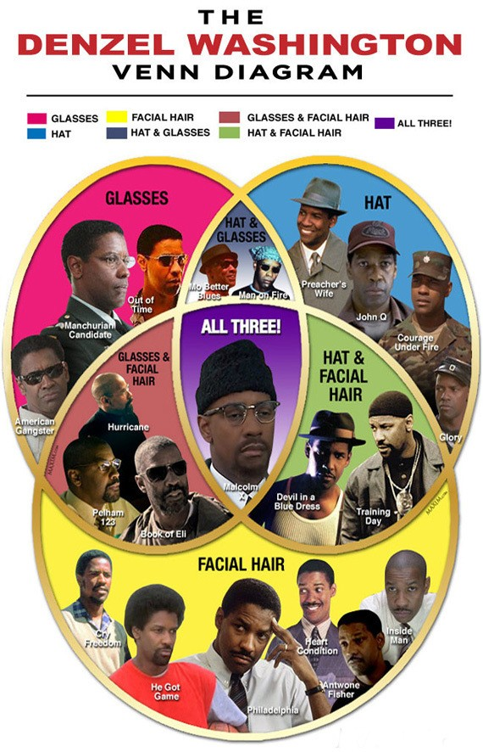
𝛀 = 21 Denzels
A = Denzel wears glasses
B = Denzel wears a hat
Are the glasses and hat events independent?

Slide 58
𝛀 = 21 Denzels
G = Denzel wears glasses
H = Denzel wears a hat
Are the glasses and hat events independent?
P(G) = 9/21 = 3/7
P(H) = 9/21 = 3/7
P(G ∩ H ) = 3/21 = .14
P(G) ⨉ P(H) = 9/49 = .18
Wearing glasses and hat together is (slightly) less likely than we’d expect if they were independent.

Slide 59
Conditional probability
The probability of an event given
that another event has occurred.

Slide 60
We now know that glasses and hat events are not independent.
New movie coming soon: you’ll win $1000 if you correctly guess whether Denzel’s character will have facial hair.
What do you do?

Slide 61
𝛀 = 21 Denzels
FH = 12/21 = 57%

Slide 62
𝛀 = 21 Denzels
P(FH) = 12/21 = 57%
So Denzel has had facial hair is 57% of movies- you’d be smart to guess that for a new Denzel movie, yes, he would have facial hair!

Slide 63
𝛀 = 21 Denzels
P(FH) = 12/21 = 57%
BUT: just before you enter your answer, you spy the new movie poster- Denzel has a hat on!
This is new information!
What do you do?

Slide 64
𝛀 = 21 Denzels
P(FH) = 12/21 = 57%
P(H) = 9/21 = 3/7
P(FH | H) = 3/9 = 33.3%

Slide 65
Law of total probability

Slide 66
Law of total probability in English

Slide 67
Bayes’ rule

Slide 68
Bayes’ theorem
Reverse the conditioning using the definition of conditional probability

Slide 69
Derive Bayes’ law

Slide 70
Bayes’ rule
From the law of total probabilities we know that P(B) can also be stated this way:

Slide 71
If you have HIV, the probability of testing positive on an HIV test is 99.9%. If you don’t have HIV, the probability of testing negative on the HIV test is 99.99%. In Oregon, about 8 people per 100,000 have HIV. Imagine you select a person at random and give them an HIV test. If the HIV test is positive, what is the probability that they have HIV?

Slide 72
Your turn
T = {test is positive}
H = {has HIV}
P(T|H) = 0.999
P(T’|H’) = 0.9999
P(H) = 0.00008 (8*10⁻⁵)
We want to solve for P(H|T)
P(T) = ?

Slide 73
Your turn
T = {test is positive}
H = {has HIV}
P(T|H) = 0.999
P(T’|H’) = 0.9999
P(H) = 0.00008 (8*10⁻⁵)
We want to solve for P(H|T)
P(T) = P(T|H) ⨉ P(H) + P(T|H’) ⨉ P(H’) = 0.999 ⨉ 0.00008 + (1 - 0.9999) ⨉ (1 - 0.00008) = 0.000179912

Slide 74
Your turn
If the HIV test is positive, what is the probability that they have HIV?

Slide 75
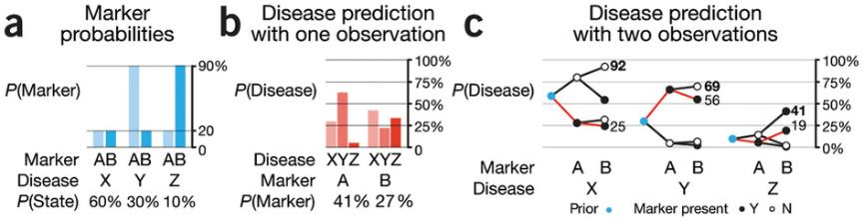
Bayes’ rule
http://www.nature.com/nmeth/journal/v12/n4/full/nmeth.3335.html

Slide 76
“Yes; you should switch.” –Marilyn vos Savant
The first door has a 1/3 chance of winning, but the second door has a 2/3 chance.
Here’s a good way to visualize what happened. Suppose there are a million doors, and you pick door #1. Then the host, who knows what’s behind the doors and will always avoid the one with the prize, opens them all except door #777,777.
You’d switch to that door pretty fast, wouldn’t you?

Slide 77
Use Bayes to solve Monty
A = {You picked the car first}
A’ = {You picked a goat first- remember 2 goats}
P(A) = 1/3; P(A’) = 2/3
B = {Monty shows you a goat after you pick}
Remember, he can show you goat 1 or goat 2
P(B|A) = 0
P(B|A’) = 1
P(A|B)?
Use law of total probability to solve for P(B):

